Slide 1

Creating a Pokédex Pokémon Detection Using YOLO
Henin
DSC680
2020
Notes:
Welcome to my final project. This time we are going to be looking at creating a Pokedex by detecting Pokémon using the YOLO model.

Slide 2
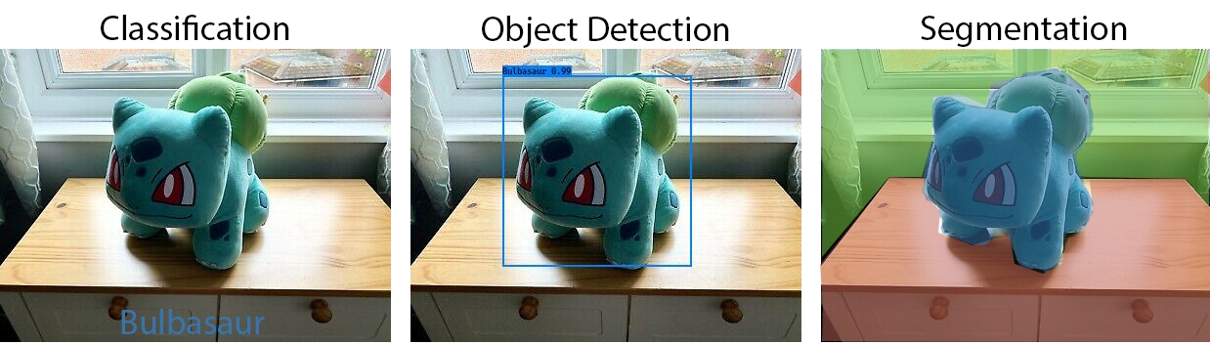
Introduction
Computer Vision (CV)
Computations of visual content, including images and video.
Computers do not know what they are looking at, need to train them.
CV falls into mainly three different categories:
Notes:
Computer Vision, CV for short, is a field of research that deals with computationally processing visual content, such as images and videos. A computer does not know what it is looking at when it “sees” a visual content. By training it, we can try to give it this ability.
At a high level, there are three main categories that computer vision falls into:
Classification, where it tries to identify what the object is.
Object Detection, where it tries to detect the boundary points of an object.
And Segmentation, tries to assign each pixel to a regional zone.
Having focused on Classification in a prior project, this project focuses on Object Detection.

Slide 3
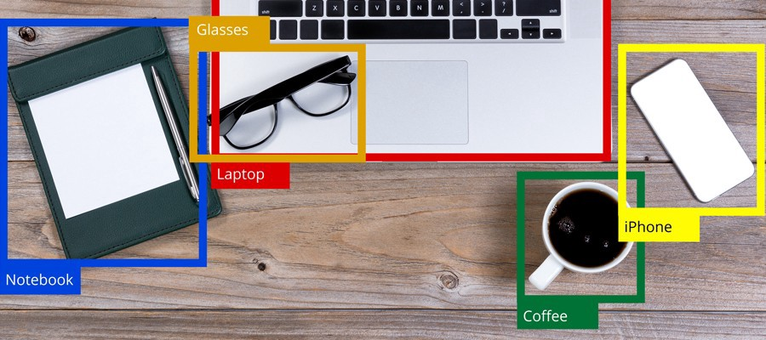
Object Detection Characteristics
Object Detection focuses on identifying where an object is within a given space.
It’s distinguishing feature is it’s ability to tag multiple objects within a single visual space, rather than just a single object.
Generally object detection also has classification built into it as a form of error checking, but the tag doesn’t always have to be displayed to the user, e.g., human faces.
Notes:
Since this project is focused on Object Detection, let’s talk about it’s characteristics.
First, object detection focuses on identifying where objects are within a visual field.
I say plural because true object detection has the ability to detect multiple objects. Single object detection is actually called Classification with Localization.
Object detection is represented by a colored box, known as a bounding box, around an object. Most of the time, the label for what the object is, as well as the confidence level is also displayed. But this is not always the case, probably the most well known version of object detection, human faces, usually do not show any labels.
What we’ll see later, is that detecting the bounding box AND classification can be a challenge.

Slide 4
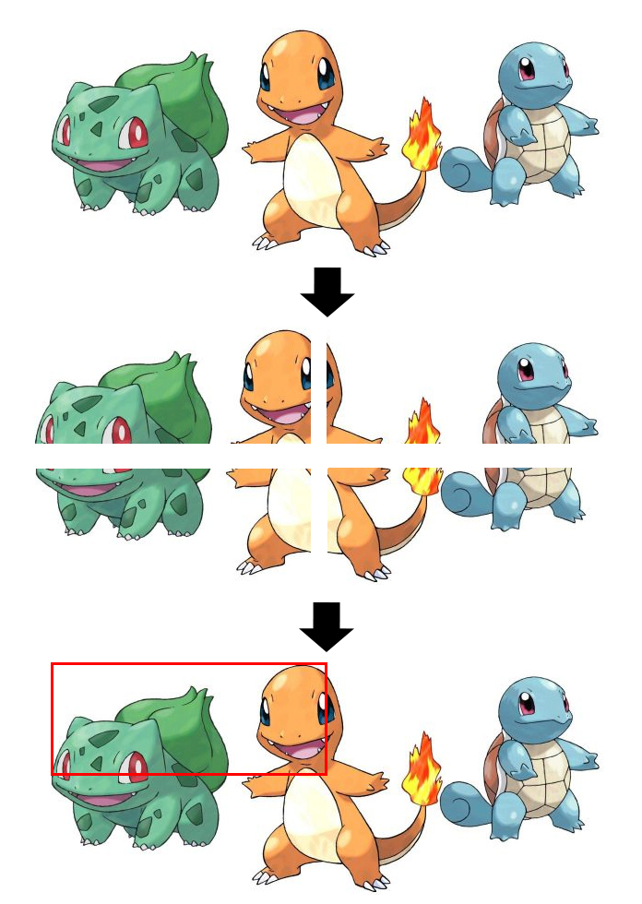
Using CNN for Object Detection
Convolutional Neural Networks identify (classify) images, by breaking an image into regions, and scanning over each one.
If an object is detected in that region, the whole region is highlighted.
This has problems because we do not know how much space an object is going to take up in the image.
If it’s very large, we might not highlight all of it, and if it’s very small, we could highlight too much.
In order to deal with smaller objects, you have to break an image into smaller and smaller boxes and this is computationally expensive.
Notes:
In my last project, we focused on using Convolutional Neural Networks for classifying images, but can they be applied to object detection?
Well, the way Convolutional Neural Networks work is they break an image down into sub-images, and they scan those sub-images one at a time with a sliding window, trying to detect features.
If we did use this approach, we could highlight the box that did find a match.
However, the biggest problem with this approach is that we do not know how big or small the object is in the visual space.
If the object is too small, we could end up highlighting a box that has multiple objects in it but only calling it one thing, as we see with our Bulbasaur and Charmander here.
The only solution to this is to break up our image into smaller segments, but this comes at the cost of increasing computation as each box needs to be compared one at a time.
As well, if you break an object into really small objects but the object is actually very large, what box do you highlight?
The box would be very tiny in comparison to the actual object.
All in all, Convolutional Neural Networks as they traditionally work, aren’t a great solution for Object Detection.

Slide 5
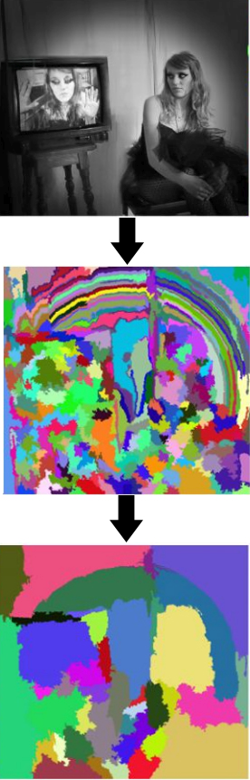
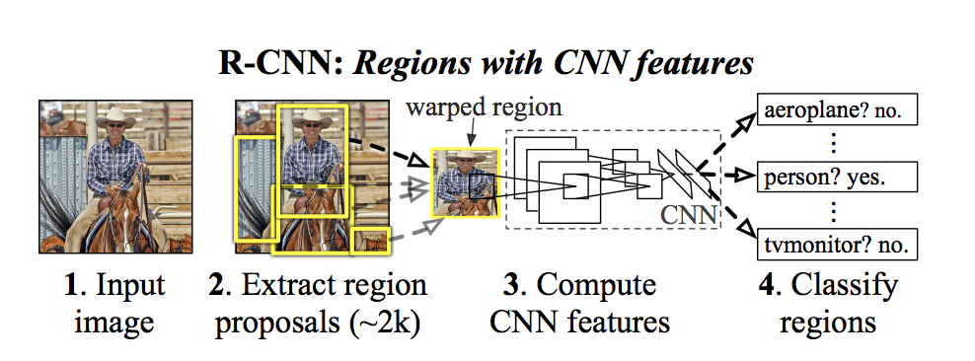
Along comes RCNN
Region-Based Convolutional Neural Networks (RCNN) tries to propose boxes (regions) first and then tests them to see if they contain anything. Models that fall under this are R-CNN, Fast R- CNN, and Faster R-CNN.
R-CNN and Fast R- CNN use what is called selective search to identify what the boxes should be. This works by identifying patterns using varying scales, colors, textures, and enclosures.
Accurate, but slow!
2000 separate runs through a CNN
Takes about 20-50 seconds per image.
Fast R-CNN reduces 2000 Regions to 1. Time lowered to 2 secs.
Region Detection via Selective Search
https://youtu.be/NM6lrxy0bxs
Notes:
To solve the issues with regular Convolutional Neural Networks, a new method was created called Region-Based Convolutional Neural Networks (or RCNN for short).
The first step this network takes is it tries to detect regions by using Selective Search. This is an algorithm that tries to identify patterns by using varying scales, colors, textures and enclosures. The engine then condenses the number of regions and extracts from them region proposals (about 2000 of them). Each one of these proposals is passed independently through a convolutional neural network which tries to see if it can classify it, anything it can’t classify gets tossed.
As you can image, running 2000 convolutional neural networks per 1 image takes a long time, roughly 20 to 50 seconds per image.
The original author later optimized this engine (called Fast R-CNN), to only needing to do one pass through a convolutional neural network, lowering the time it took dramatically to about 2 seconds per image.
Joseph Redmon, the lead author of the model we’ll get to later, gave a great analogy in the linked video when he was comparing the models. He compared the distance a car would go travelling at highway speeds of 60 mph, before these models detected what object it saw. At the best case scenario for RCNN at 20 seconds, the car would have travelled 1760 feet, about a 1/3rd of a mile. For Fast R-CNN’s model at 2 seconds, that means the car would be travelling 176 feet, or about half a football field.
So while the improvement from RCNN to Fast RCNN was really good, 2 seconds to process one image isn’t going to cut it.

Slide 6
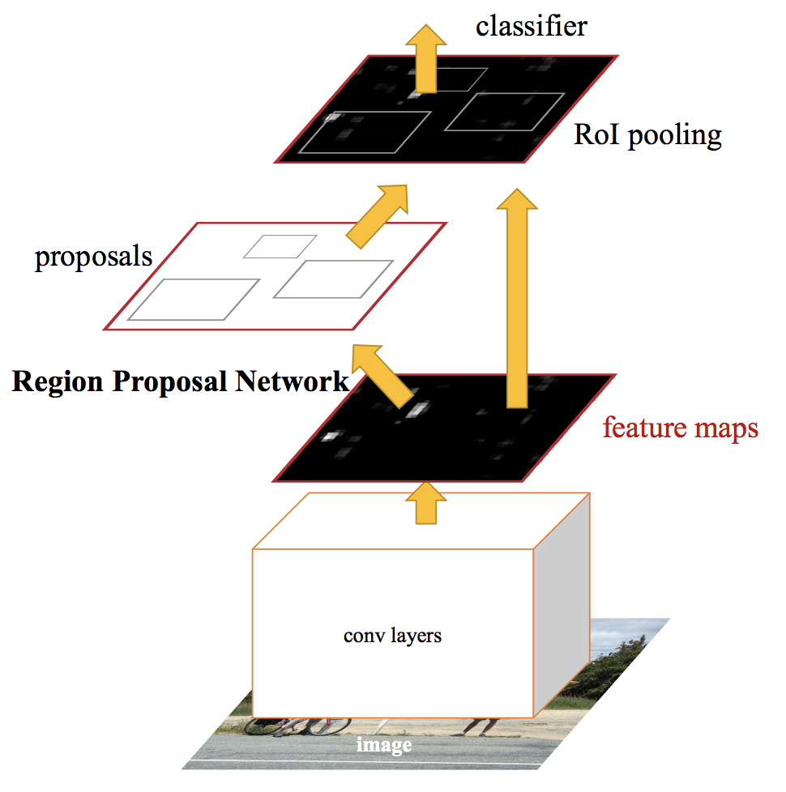
Need to go Faster
While Fast R-CNN was able to reduce speed, it hit into a wall with selective search being too slow.
Faster R-CNN solves that issue by replacing selective search with a “Region Proposal Network” (RPN).
Sliding window scans image using the feature model, and compares it versus the RPN.
Fixed size boxes are generated around the anchor point of the scanning window, each one is tested for objects and then finally tests for classification.
Still has original CNN problem of oddly sized boxes.
Faster than all previous R-CNN, at about .2 seconds per image. However that is still slow for videos, as at its fastest means only 5 FPS (phones record at ~30).
Limiting factor is the image has to be sent through a neural network twice, once for detecting the bounding box, and once for classifying (serial processing).
Faster RCNN
Notes:
Still trying to make CNN’s work, the next focus on trying to optimize them was getting rid of selective search to find proposals, as they took too long.
A new model called Faster R-CNN does this by replacing selective search with what it calls a Region Proposal Network.
This model goes back to it’s CNN roots of scanning the image with a sliding window, and comparing features. But this time, rather than just using the size of the sliding window, the window creates k number of fixed sized boxes around the center of the window, called anchor boxes. Each anchor box is checking for features and the ones above a certain threshold get sent as proposals to the classifier layer to get a label.
Now by going this method, we trade the accuracy of the bounding box, by replacing them with more generic and sometimes odd shaped boxes, but we gain a lot more speed; it can process an image in about .2 seconds. This is certainly fast, but if we put this in terms of video processing, that means it can only process at about 5 frames per second, a typical phone records at 30 seconds frames per second. Back to the car analogy, this time the car would have travelled about 12 feet, while much better, it could still mean the car hits into the car in front of it.
So what is left to optimize? Well, like all the models we have discussed so far, object detection is a 2 step process. First the image goes through a convolutional neural network that tries to find regions, and then after that is done, it sends those regions through another convolutional neural network to classify that region. This has to be done serially because what this model is doing in lay person terms is it’s cropping the area of a single picture and then does classification on each of those individual crops. So the question is, can it be done in less steps?

Slide 7
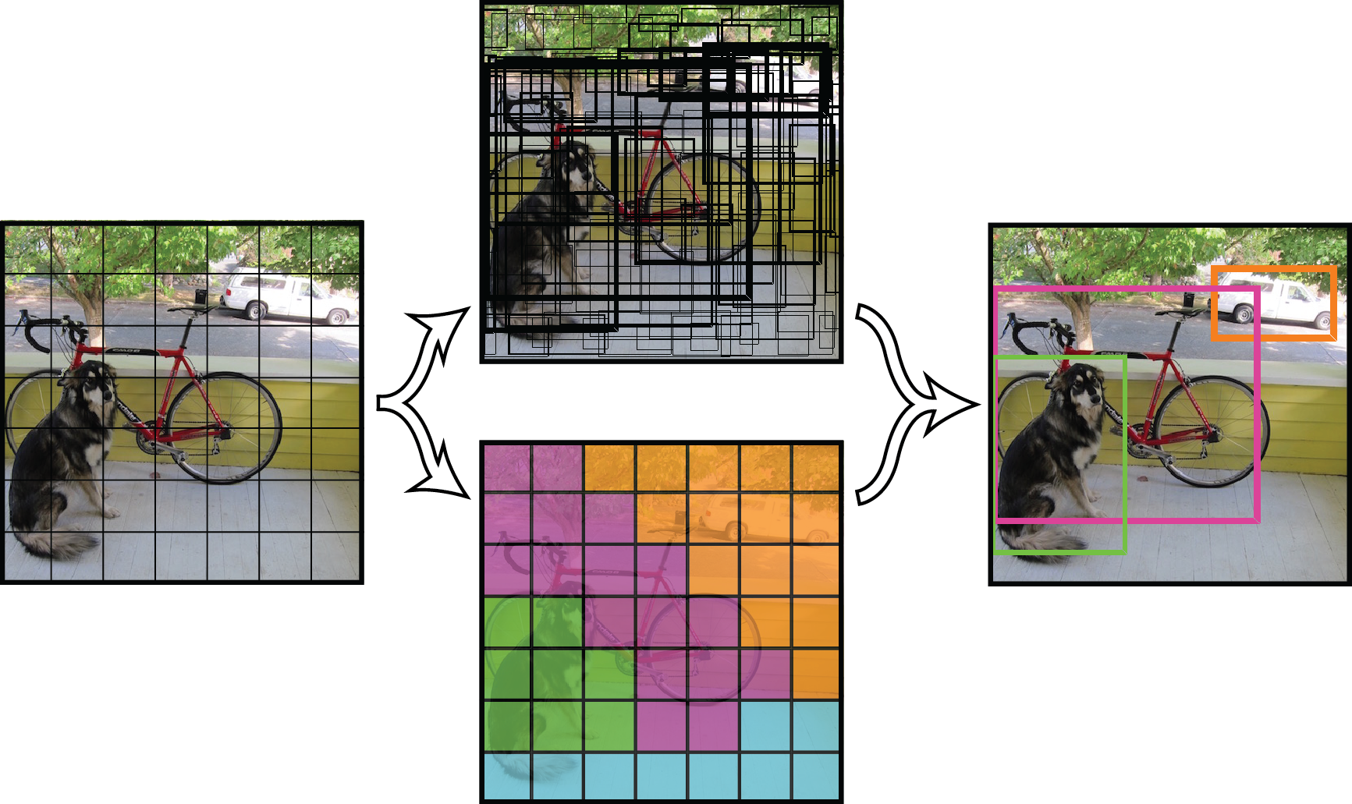
Life’s Too Fast – YOLO
YOLO (You Only Look Once) is a one pass model!
Solves the serial 2-pass problem by finding bounding boxes and performing classification separately, so it can process in parallel.
Steps
The image is divided into a grid of.
Bounding Boxes
Each cell generates B # of bounding boxes predictions (size and confidence that it contains an object).
Classification
At the same time, each cell is predicting class probabilities.
2.
Class Probabilities * BB Confidence Level = Detection & Classification.
Processes at around 30-45 FPS!
YOLO v1 Architecture
Notes:
Going from two step process, to a single step, is exactly what YOLO does, which stands for You Only Look Once.
The reason for this is because image classification is not reliant on the bounding boxes. So each task is done in parallel.
The first step is the image is divided into a grid of cells.
These cells are used both for bounding boxes and in classification.
For the bounding box, each cell generates B number of bounding box predictions, typically between 3 and 5, and gets a probability for each the likelihood it contains an object.
At the same time, classification is being done on the grid. Each box predicts the which class it belongs to.
The bounding boxes that meet the threshold for object detection are multiplied by the class probabilities. Intersecting boxes are combined, resulting in a final output of a bounding box with a class label and probability.

Slide 8
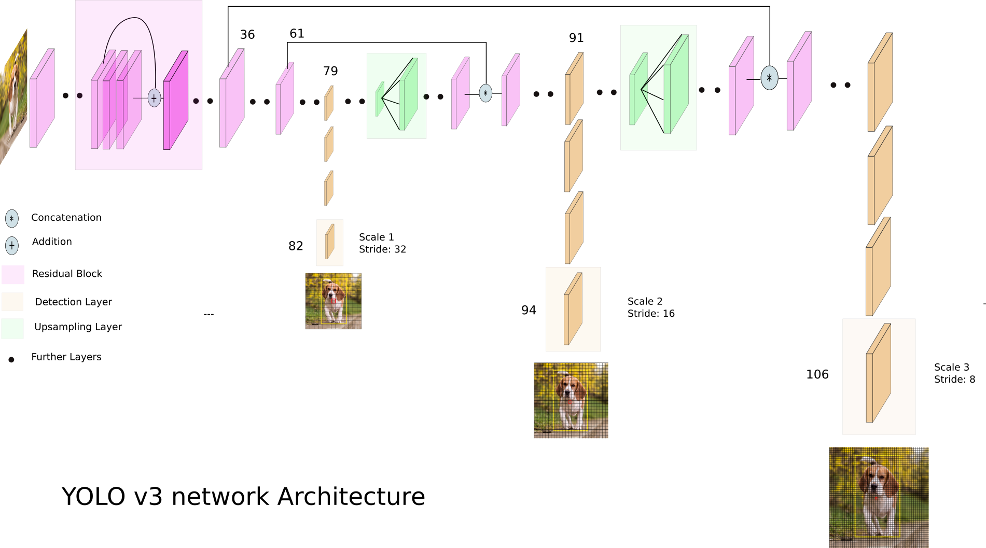
YOLO(v3)
YOLO is now on version 3 and there have been changes to the model. Why?
The “winner-takes-all” model for classification made overlapping objects difficult to detect.
To solve this, the following changes were made:
CHANGES
The image is now divided 3 times at three different scales.
Classification changes from Softmax function (One label) -> Multilabel Logistic Regression (Multiclass)
Tensor = N x N x [B * (4 + 1 + C)]
N x N = Size of grid
B = # of Bounding Boxes per cell
4 = Number of bounding box attributes
1 = Object Confidence
C = Number of Classes
Notes:
The biggest challenge for YOLO was detecting multiple objects that overlapped due to the winner take all methodology, which lead to further models. We are going to be using the latest version, version 3.
They tried to solve for the overlap issue by processing an image at three different scales.
And rather than use a Softmax function for classification which results in only one label per cell; a Multilabel logistic regression is applied across all classes.
This means the number of bounding boxes being checked has increased dramatically. On the COCO dataset which has 80 classes, this means going from 98 bounding boxes in YOLO version one to 10,647 in version three. This increases accuracy but it does come at the cost of slowing down the model. Though, it is still faster than other Object Detection algorithms.

Slide 9
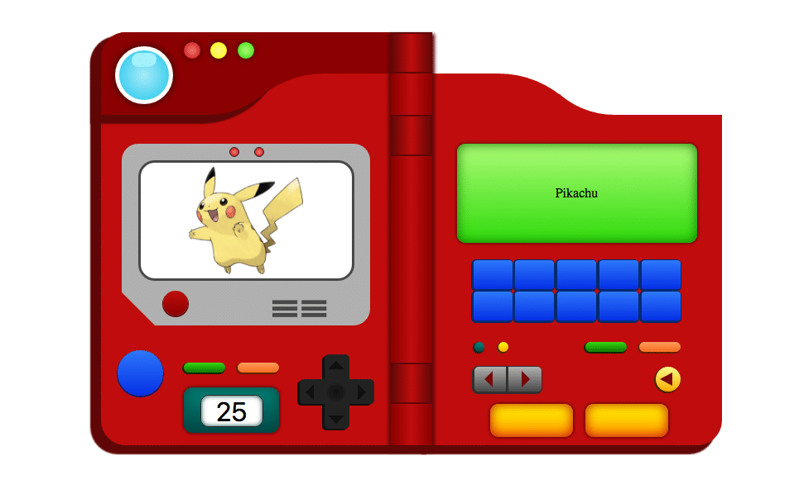
Purpose and Dataset
Purpose
Mimic the ability of a Pokedex.
Detect Pokémon using the YOLOv3 Object Detection algorithm.
Dataset
Pokémon images dataset, originating from Kaggle dataset named Pokémon Generation One, which was uploaded by Harshit Dwivedi.
While the data is provided under a General Public License (v2), the images were obtained through web scraping, so rights to all data images is not known or claimed by this project.
Total of 10,706 images.
149 Classes. Dataset claimed 151, one for each Pokémon, but Nidoran (male or female) is not included.
No bounding box information was provided, just the images.
Lots of image duplication and misclassification, not enough time to clean all 10,000+ so a subset was chosen.
Notes:
With all that said, let’s get into what this project is actually all about.
The goal of this project is to mimic the abilities of a Pokedex. For anyone not familiar, a Pokedex is a handheld device in the Pokémon world that will detect the type of Pokémon that it sees and present information on it.
The way we will do this is by training a YOLO version 3 algorithm on Pokémon.
The dataset that was used is a Kaggle dataset named Pokémon Generation One which consists of a total of 10,706 images of Pokémon.
The images are divided into 149 folders, which is 2 short of all the Pokémon in Generation One, as it’s missing Nidoran (both the male and female version).
No bounding box information was provided, it’s just strictly the images in a bunch of folders.
Now the way this data was acquired was through web scraping, and it is apparent that there are quite a few duplicates and misclassifications. In order to use this data, we’ll need to clean it up and prep it.

Slide 10
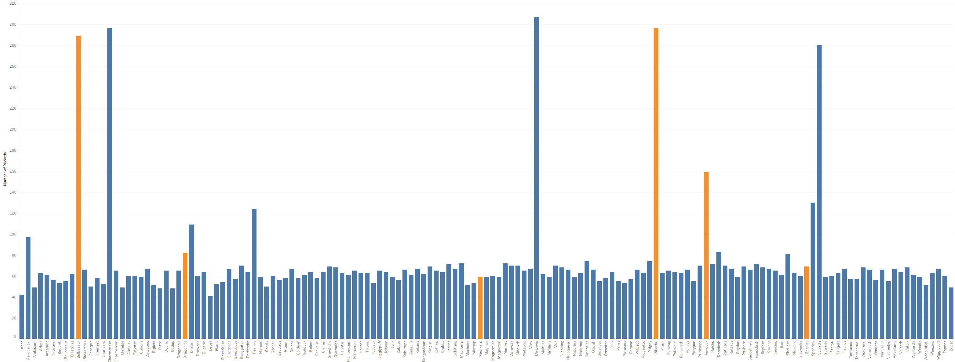
Pokémon Distribution
Graph 1. Barplot showing count of images by Pokémon. Bars in Orange are Images Used in training.
Notes:
Here we see a distribution of Pokémon images. Rather than try to go through and clean every up every image of every class. I chose just a few of the classes to go through, which are highlighted in orange here. As you can see, these classes are not evenly balanced, so seeing how well the model will handle this will be interesting. I picked these specific ones out because I wanted to test the object detection on my son’s Pokémon stuffed animals, and these were the ones he had.

Slide 11
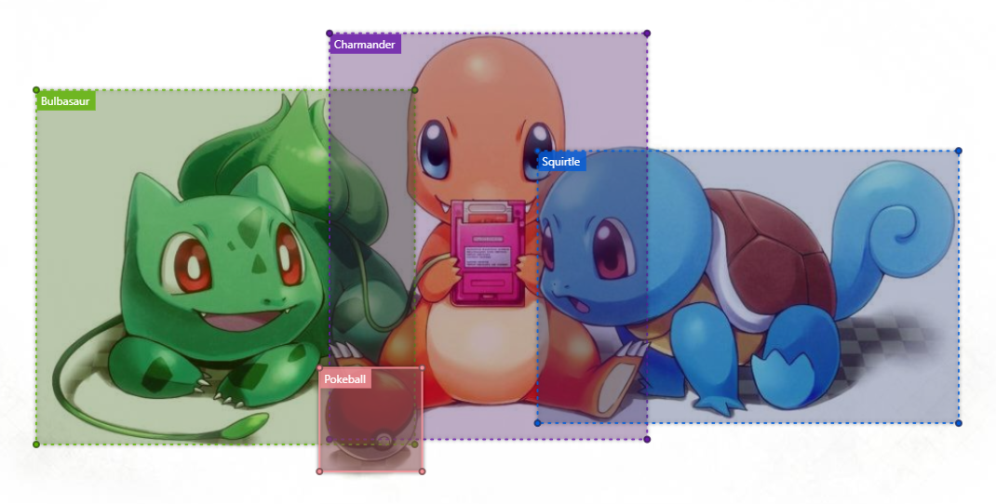
Image Tagging
YOLO requires 6 pieces of information:
Image name, xmin, ymin, xmax, ymax, and label.
No labels in dataset, had to manually tag images.
Used Microsoft’s Visual Object Tagging Tool (VoTT).
Allows the ability to tag multiple areas in an image (assets).
Total 845 Assets with 1135 Total Tagged Regions.
Ended up tagging objects beyond the
scope, such as the Pokeball.
Bulbasaur | 317 |  | Pikachu | 329
Charmander | 13 |  | Pokeball | 52
Dragonite | 83 |  | Psyduck | 111
Ivysaur | 11 |  | Snorlax | 87
Magikarp | 109 |  | Squirtle | 14
Oddish | 2 |  | Venusaur | 7
Grid 1. Number of Tagged Regions by Label
Notes:
YOLO requires 6 pieces of information for every object being trained. The name of the image, the 4 bounding box coordinates, and the label for the region.
Since the dataset did not provide this, that means I had to go through and manually do this. To do this, I used a tool called Visual Object Tagging Tool by Microsoft.
This allows us to import assets, which in our case are the images, and draw boxes around each object and give it a label. A single image can have multiple regions.
From the 845 images, a total of 1135 regions were tagged.
In the grid here in the corner, the ones bolded in orange, correspond to the classes chosen from the bar graph distribution. But as you can see, I ended up tagging more regions than just the initial classes, such as tagging 52 Pokeballs.

Slide 12
YOLO Model
Implemented YOLO model based on Anton Muehlemann’s TrainYourOwnYOLO GitHub project, which is available for use under the MIT license.
Training Hyperparameters
Initial pretrained convolutional weights were acquired from the Darknet53 model.
Validation set = 10% of Images
Number of classes = 12
Image Resize = 416 x 416
Epochs = 51 x2
Batch Size = 32 (13 x 13) -> 4 (104 x 104)
Anchors = 9 @ 10,13, 16,30, 33,23, 30,61, 62,45, 59,119, 116,90, 156,198, 373,326
Learning Rate = 0.001 and then reduced using ReduceLROnPlateau function.
Optimizer = Adam
Loss = yolo_loss
Metrics = val_loss
EarlyStopping function enabled
Notes:
Now that our data is ready ready, it’s time to configure the YOLO Model.
As a base, I’ve forked a GitHub project called Train Your Own YOLO, which is available for general use under the MIT license.
Here are the following hyperparameters that I’m using:
10% of the images are reserved as the validation set.
The initial pretrained convolutional weights come from darknet53, with the final weights coming after the model is trained.
The number of classes = 12
Images are resized to 416 x 416 pixels
The model is set to two sets of 51 epochs.
The first set of 51 epochs are set to a batch size of 32 (meaning a 13 by 13 grid), and the second set of 51 epochs are set to a batch of 4 (104 by 104 grid)
There are 9 anchor points set at the following x, y coordinates of the images.
The learning rate is set to point zero zero one. In the second set of epochs, the learning rate is reduced if it detects a plateau every 4 runs.
The optimizer function is Adam
The loss function is a custom yolo_loss function
The metric it evaluates performance on is set to val_loss
EarlyStopping is enabled, which stops training if it detects a long running plateau.

Slide 13
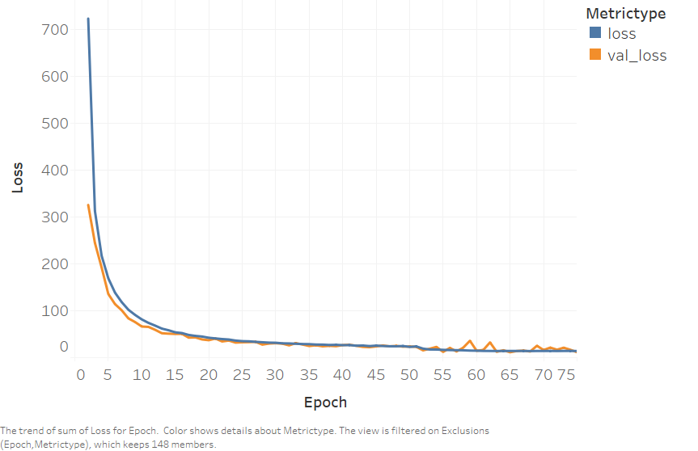
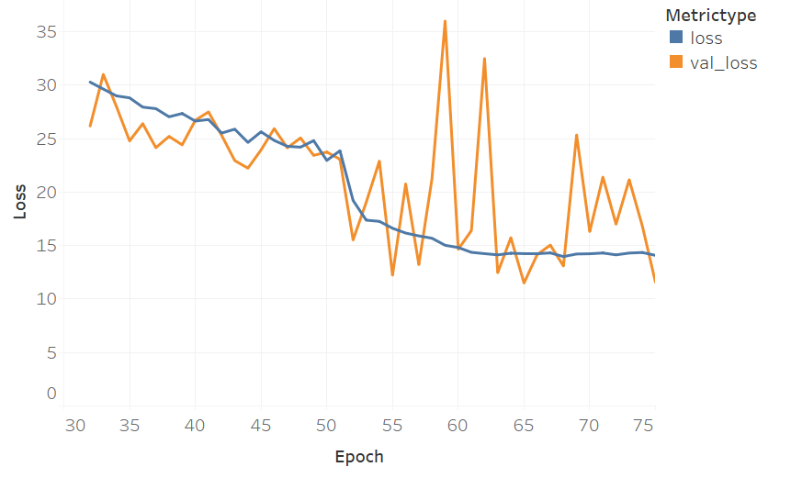
YOLO Model Training
Graph 2. Loss by Epochs for loss and val_loss metrics.
Notes:
Here is a graph showing the loss metric over the epoch number. EarlyStopping kicks in at Epoch 75, but since the scale starts off pretty high, it’s hard to see what is happening towards the end.
So let’s focus in on the last 30 epochs.

Slide 14
YOLO Model Training
Early Stopping engaged at 75 Epochs with a loss value of 11.57
Graph 3. Loss by Epochs for loss and val_loss metrics, range 30 to 75.
Notes:
Now we can see what is happening and why Early Stopping kicked in. We see that loss is still continuing down from 30 to 51. After the initial 51 Epochs the model unfreezes and is allowed to adjust all nodes, so we expect to see some gain here as it’s now fine tuning. However, the fine tuning seems to lose any gains by about 62. It is clear the gains flatten out towards the end, indicating we’ve hit our max tuning and thus why EarlyStopping kicked in. Without EarlyStopping, we would continue training for another 27 Epochs which might cause overfitting.
Now that training is done, let’s look at some of the results.

Slide 15

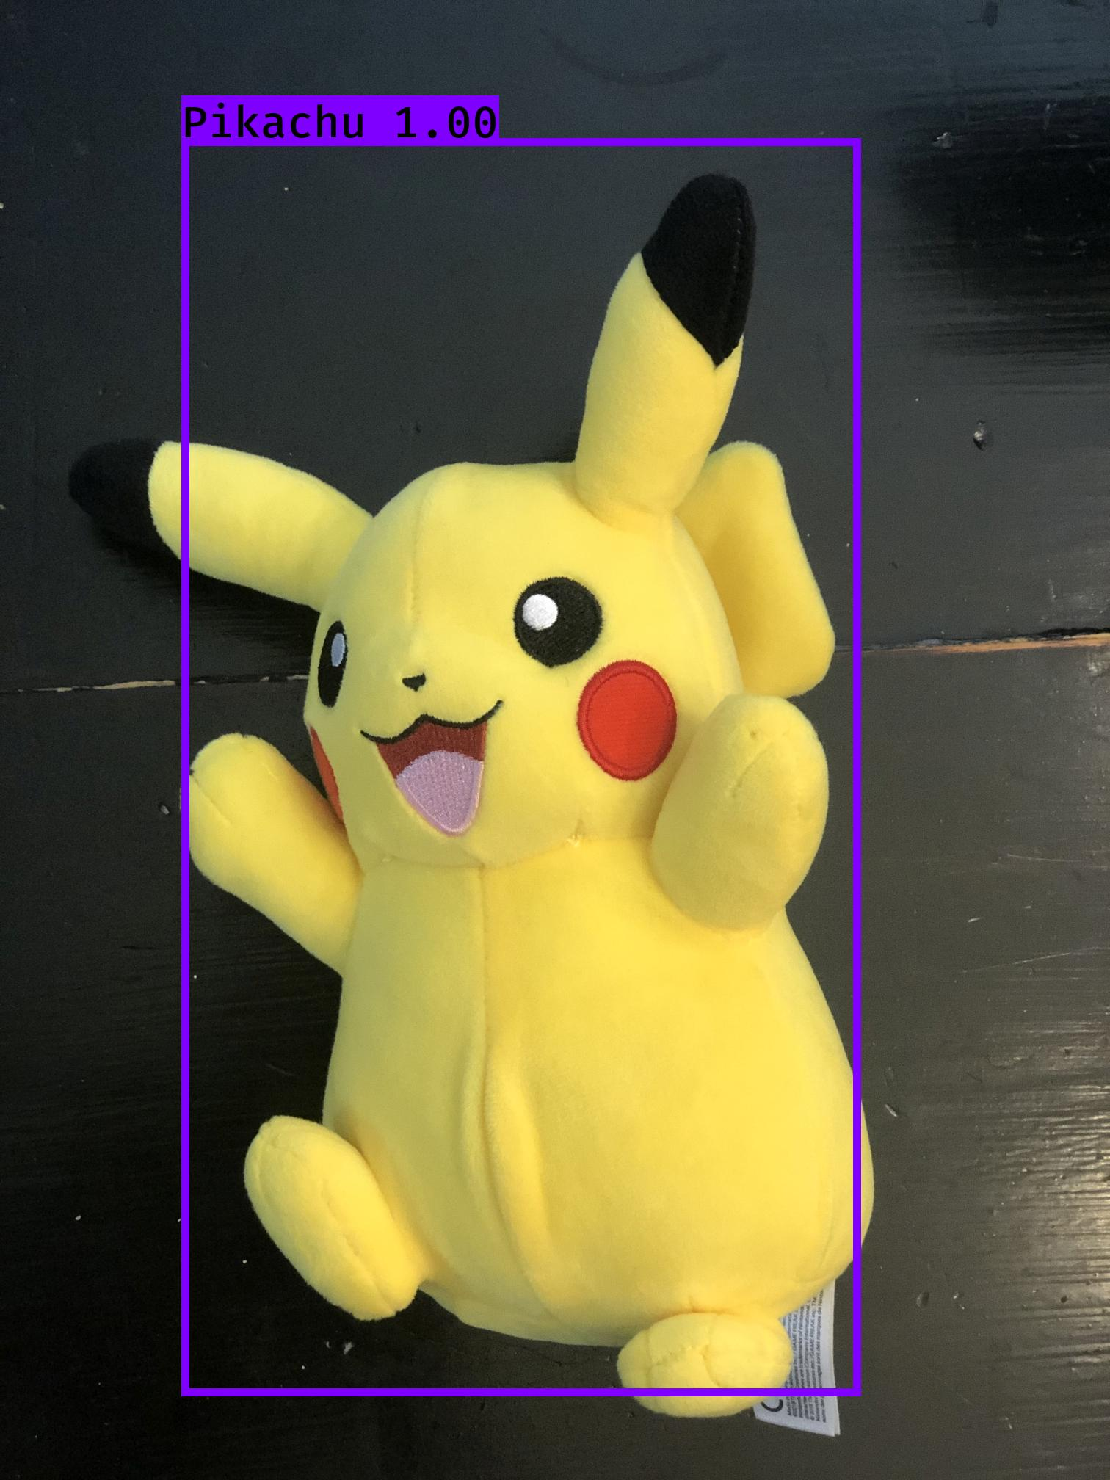
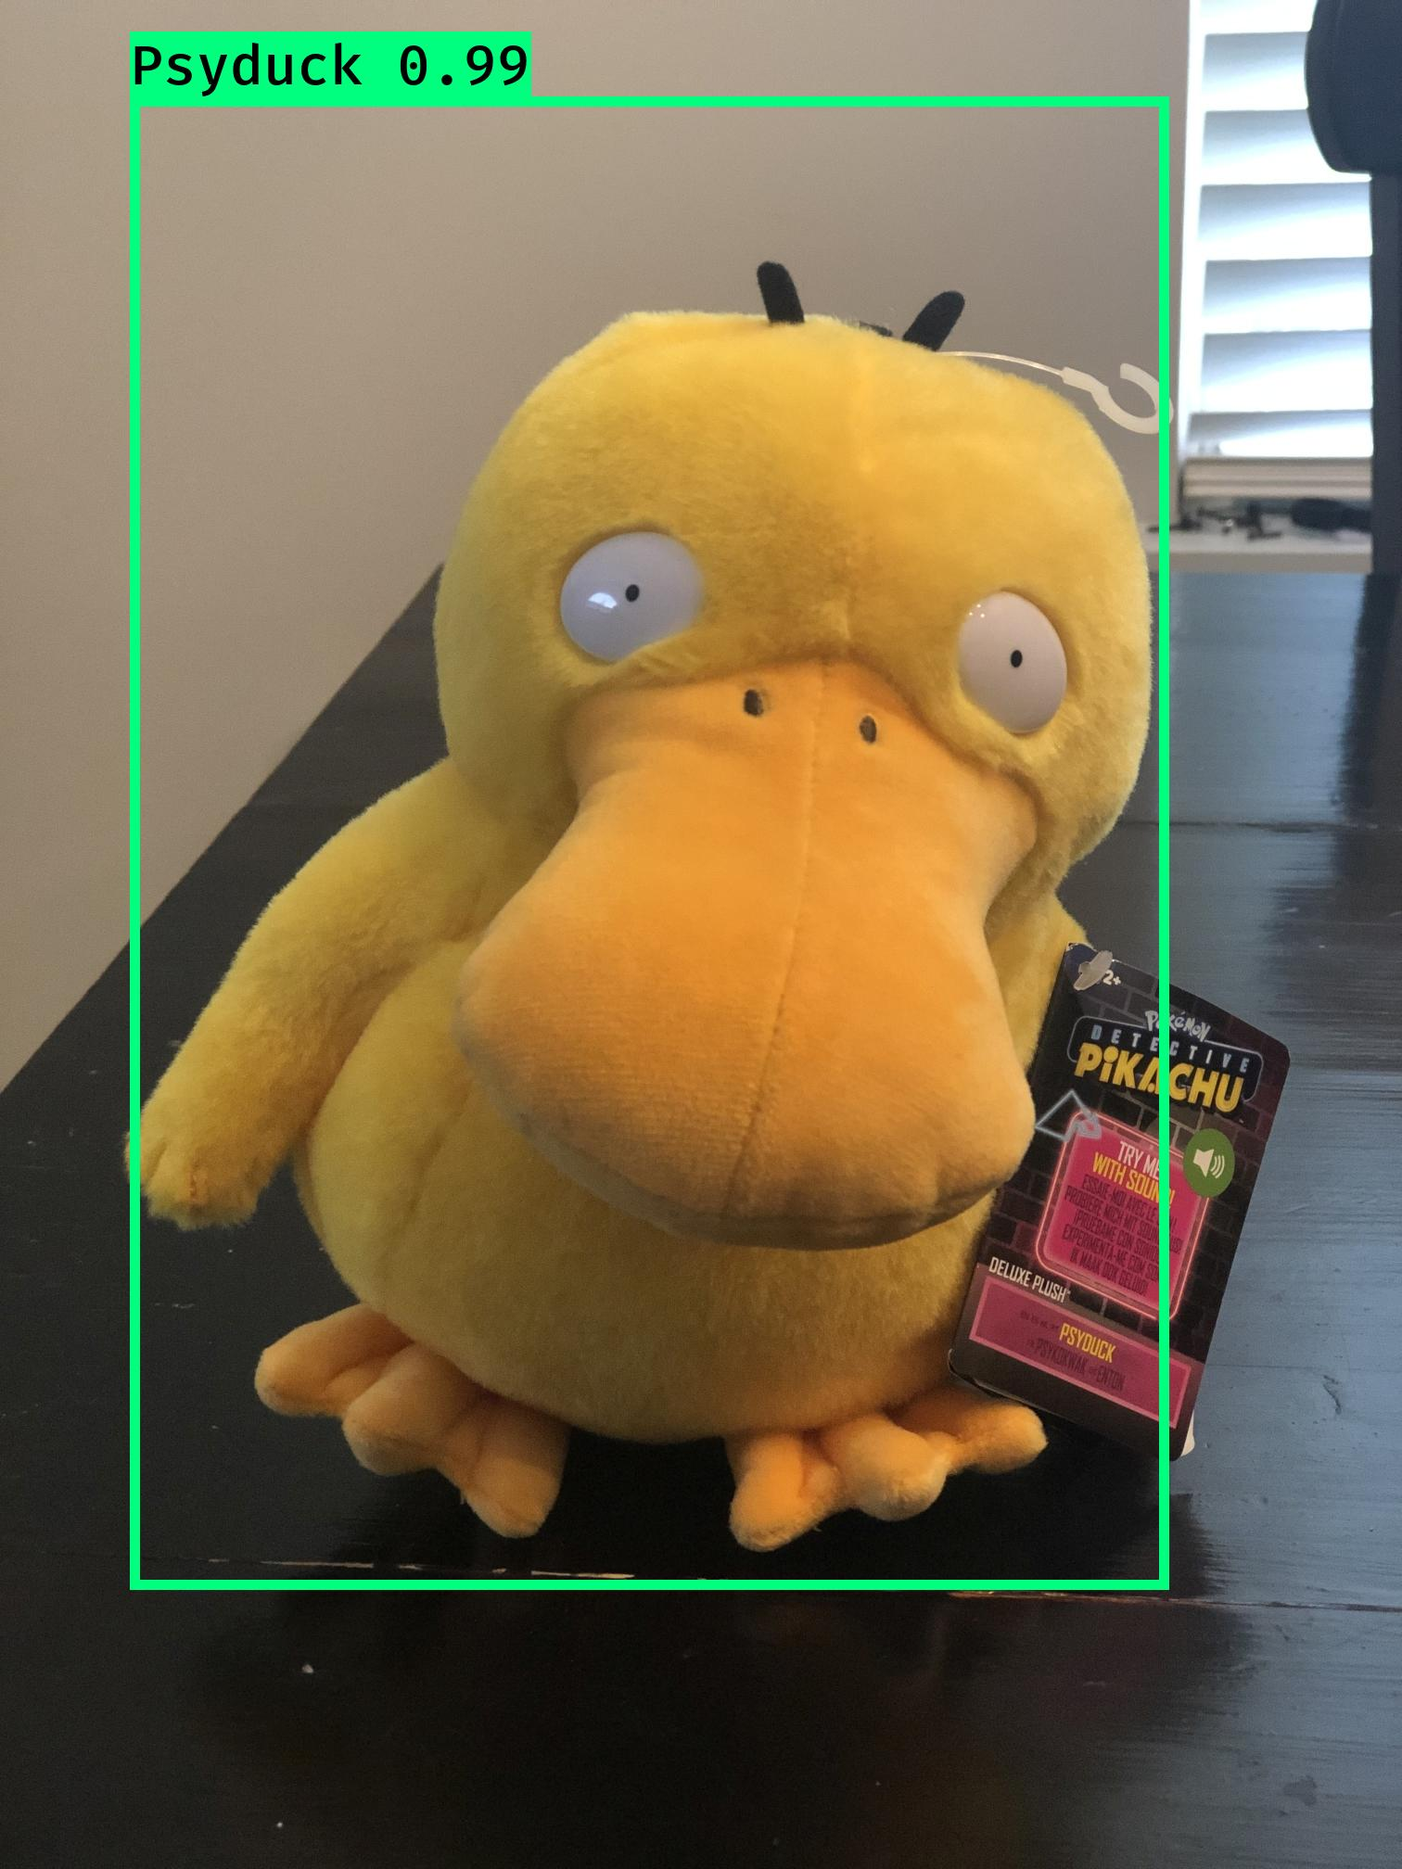
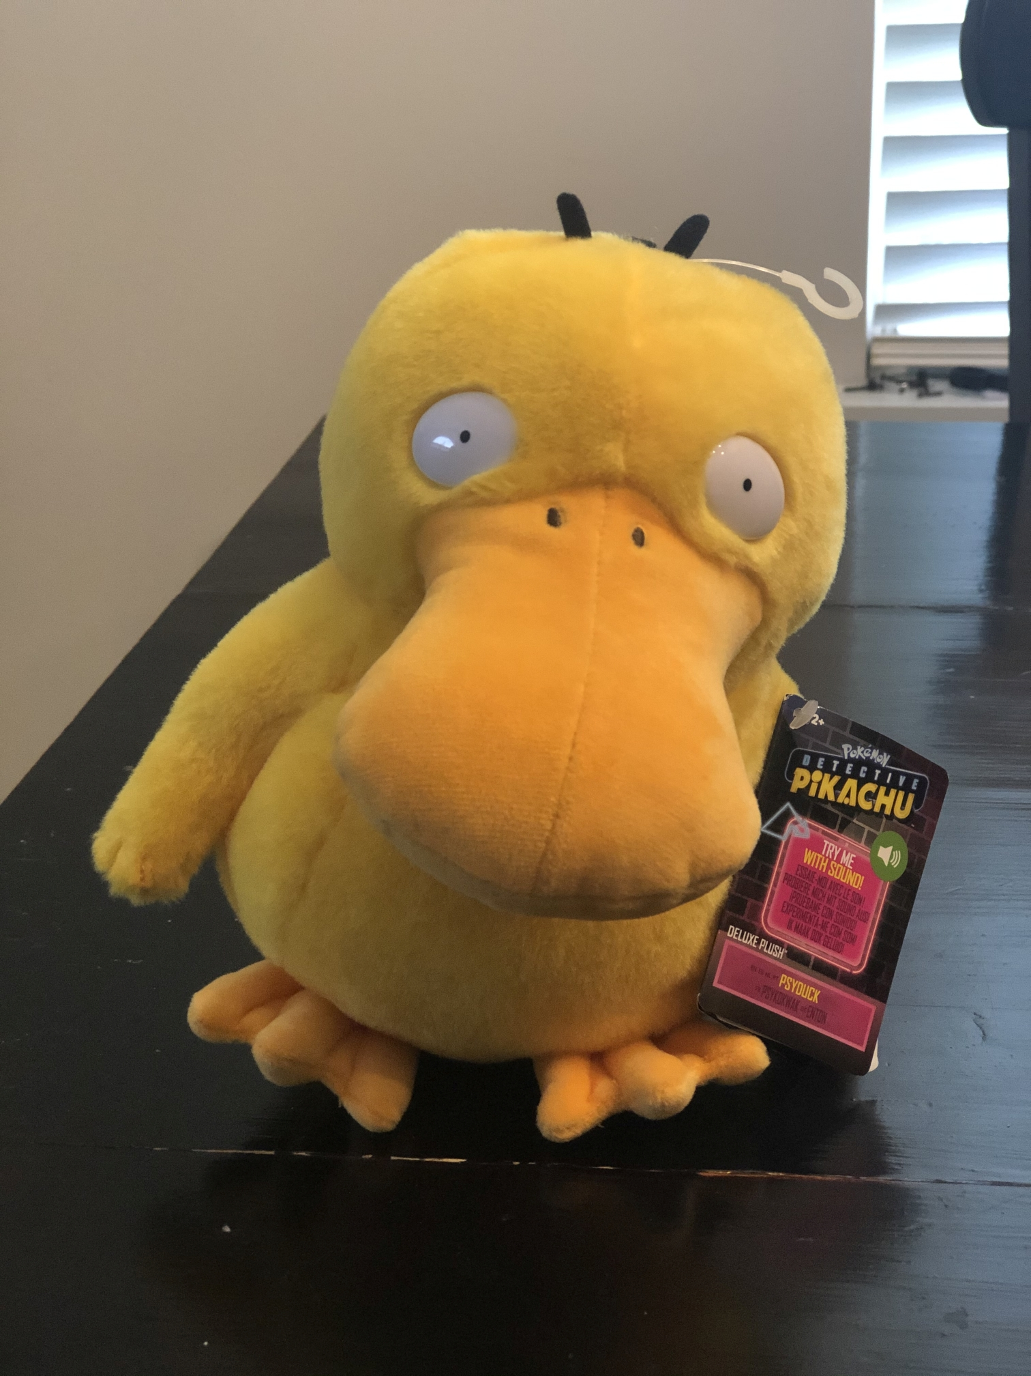
YOLO Image Results – Single Object
Notes:
In our first tests, we are looking to see how it does with single object detection (or classification with localization). The model does extremely well here, achieving accuracy ratings above 99%
But let’s see how it does with multiple objects

Slide 16

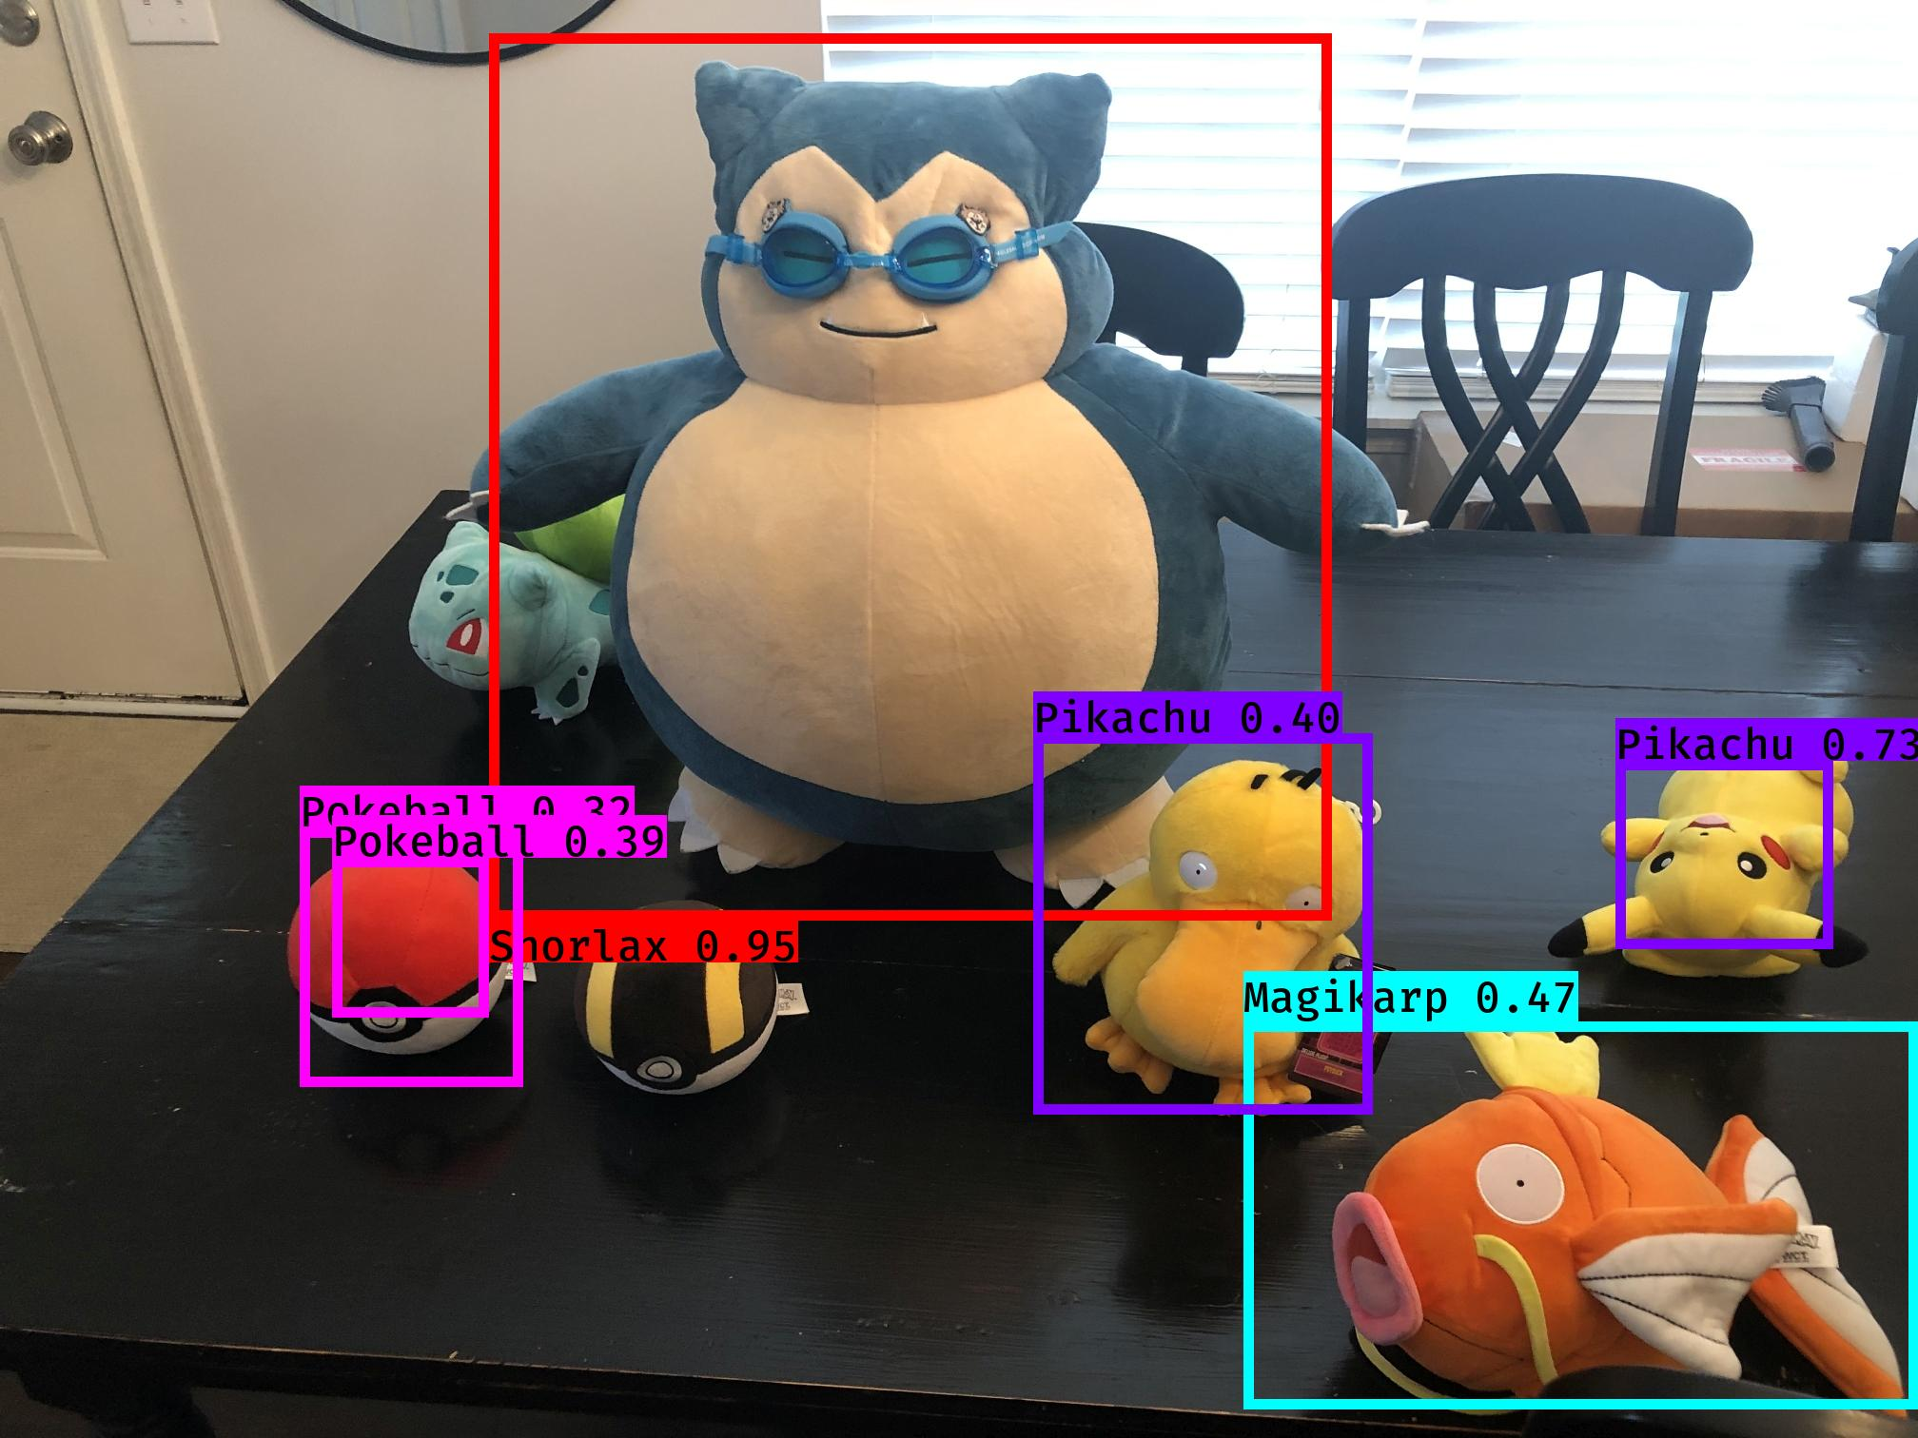
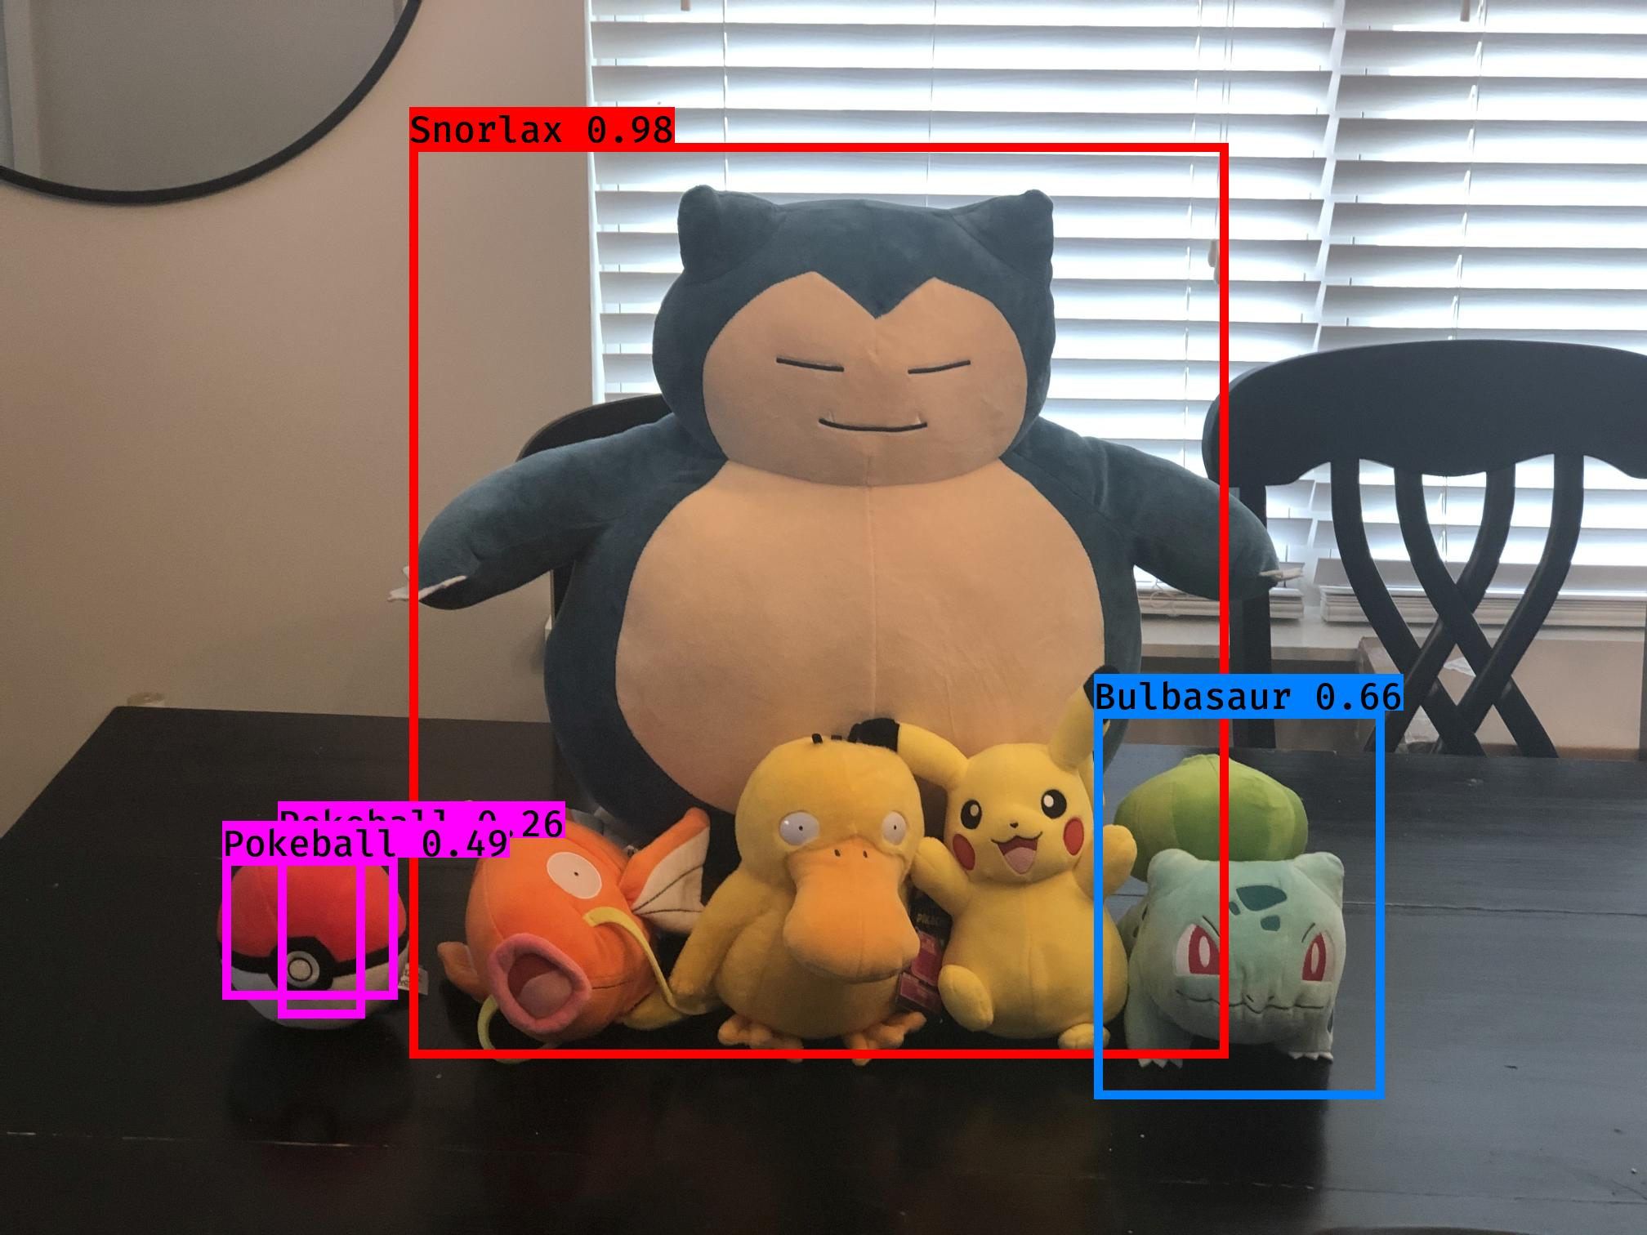
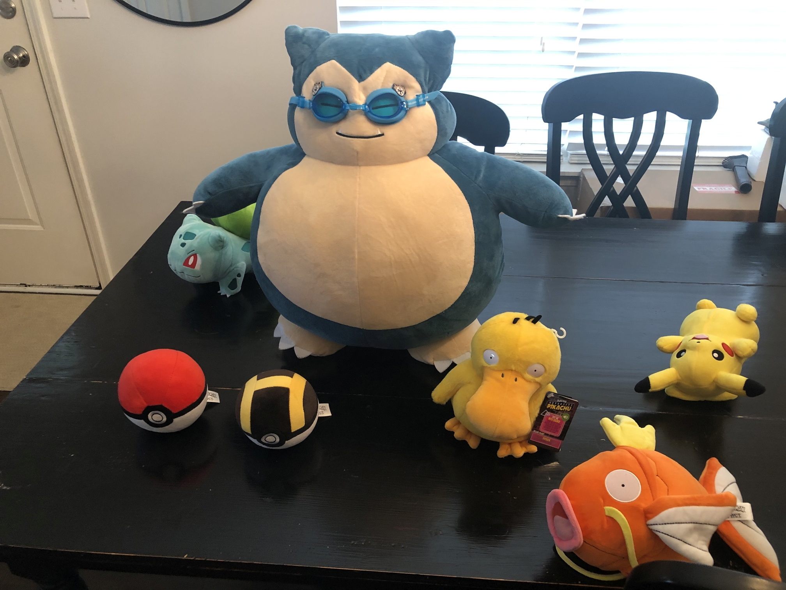
YOLO Image Results – Multi Object
Notes:
The real test of Object Detection is identifying multiple objects. If you remember, one of the drawbacks of YOLO is that it has trouble detecting objects that overlap, so two different tests are done here, one with a lot of overlap on the left, and one with very little on the right.
As we can see on the left, Objects that overlap aren’t getting classified. The bounding box of the Snorlax takes over the other Pokémon, and the only objects that get classified are the Pokeball and the Bulbasaur on the edges. We can also see that the pokeball looks to have two bounding boxes for it. This means we need to go and tweak our Non-Maximum Suppression. This is a way to clean up overlapping objects, but the threshold on that is set to the object that is over 50%. Both Pokeballs are under that threshold so we have some competing going on. We might want to drop this to 40 or 30%.
On the right, when the objects are spread out, the model does a much better job of classifying. It gets the correct Pokeball (I put in an Ultraball to see if it would be confused), we get the Snorlax, Magikarp, and even the lying upside down Pikachu. However, our poor Psyduck gets misclassified as a Pikachu. It’s no wonder he has so much anxiety. Also of interest is that the partial Bulbasaur behind the Snorlax does not get recognized. Again, this is due to the Snorlax’s bounding box just being so large.

Slide 17
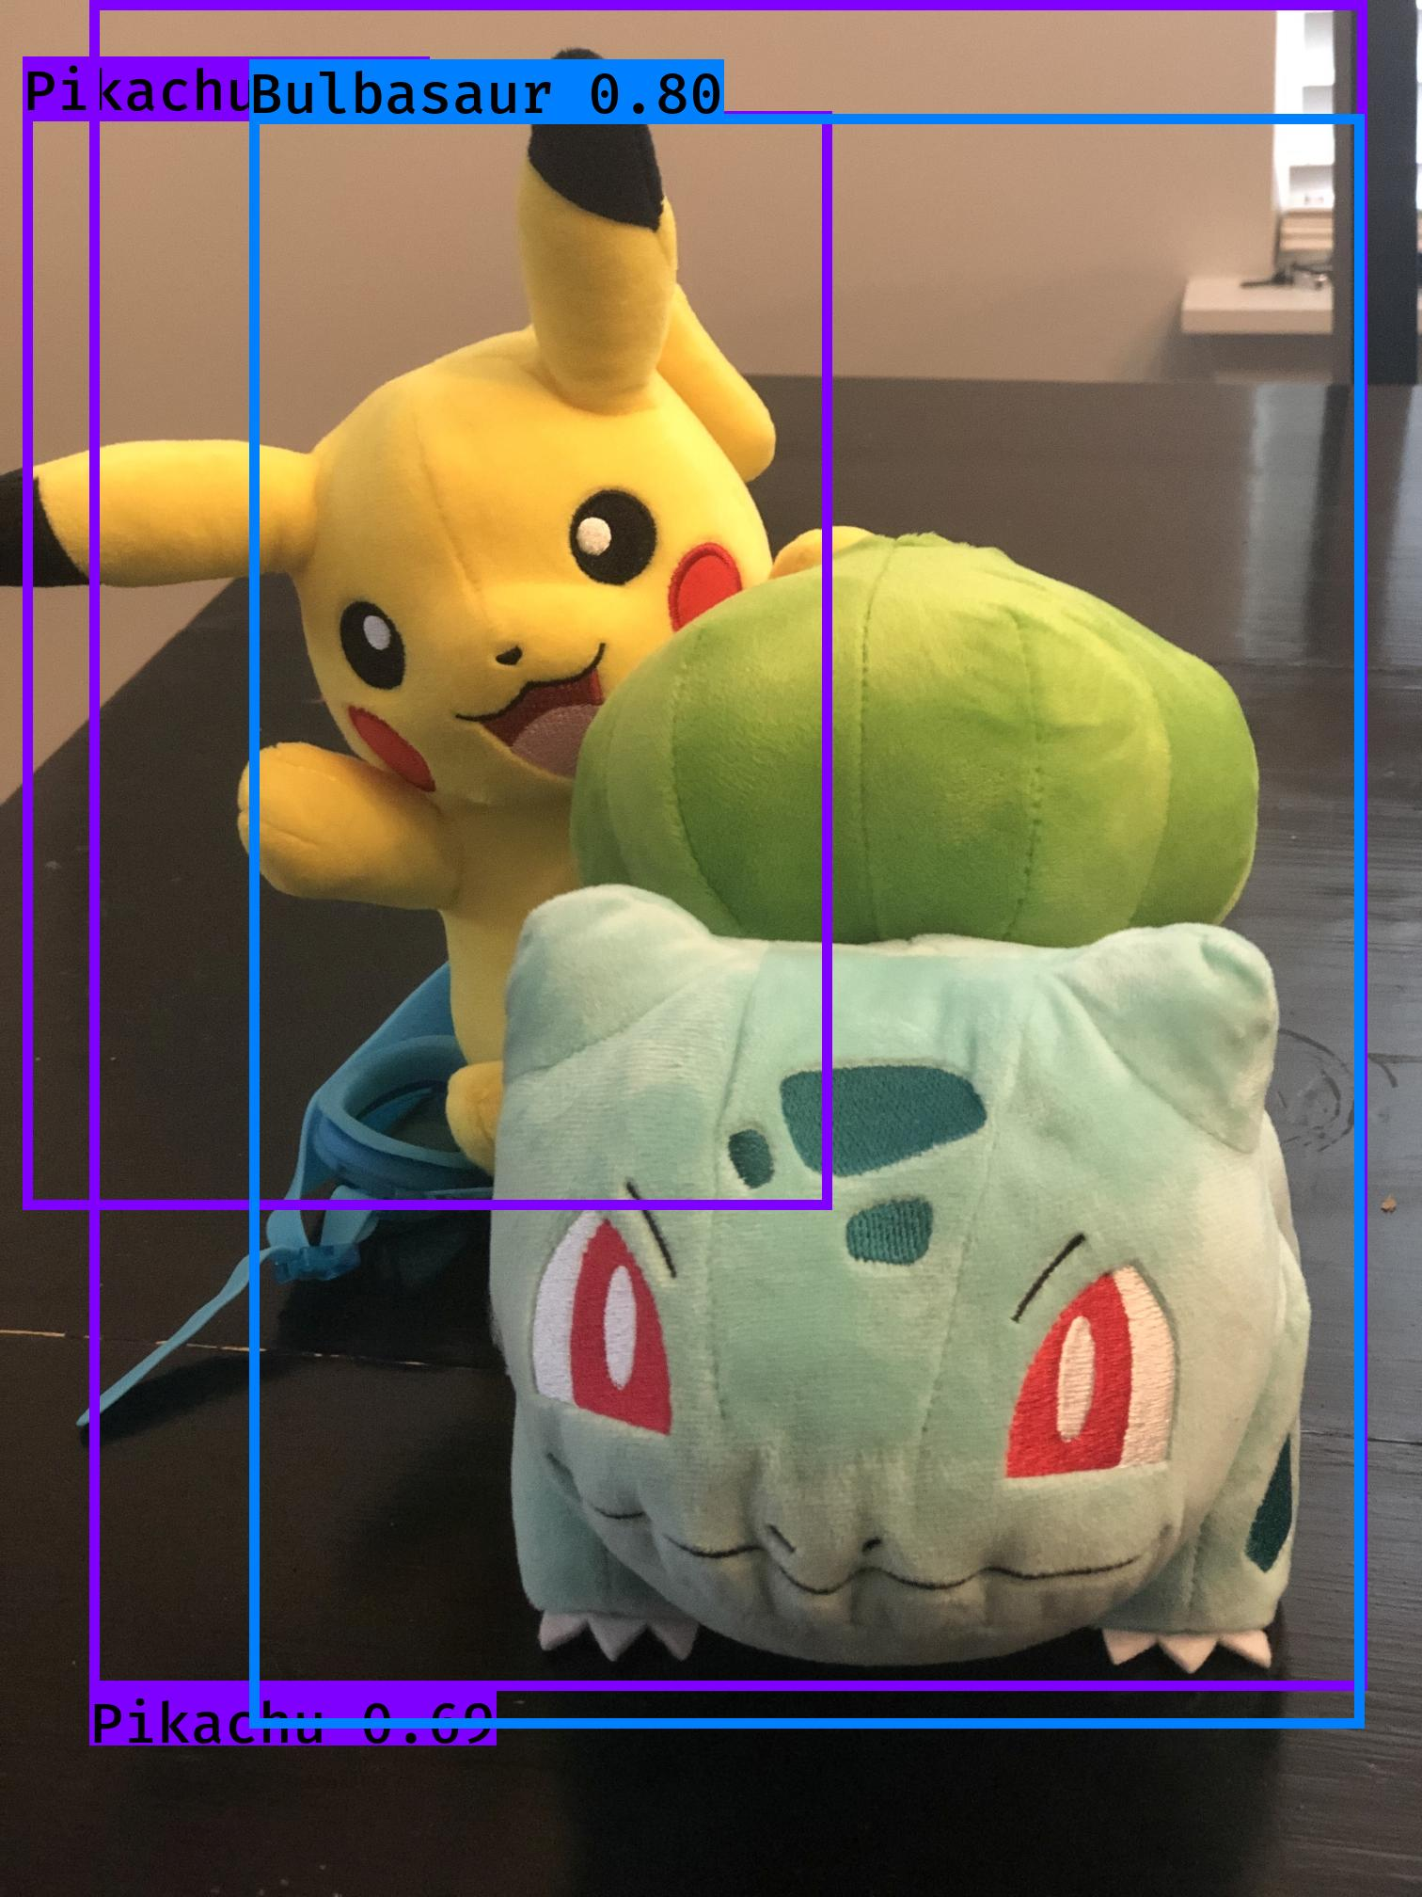

YOLO Image Results – Occlusion
Notes:
When we switch to objects that are of similar size, partial occlusion doesn’t seem to bother the model. Here we can see both the Bulbasaur and the Pikachu get correctly labeled.

Slide 18
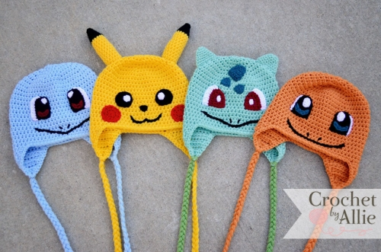
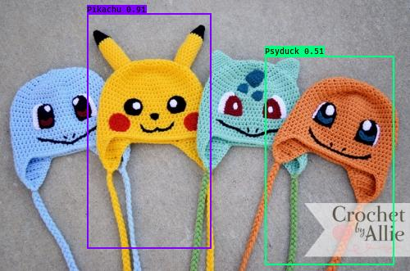
YOLO Image Results - Generalizing
Notes:
I also wanted to see how the model would generalize to things that are Pokémon but not in the traditional way. We can see that it does recognize the Pikachu hat, but it fails to either recognize the others at all, or misclassifies them. This might be strictly on how the images were tagged, as I was tagging the Pokémon’s whole bodies. It seems the model is too reliant on whole features, it might be a good idea to do some training on only partial regions, such as the face.
Now let’s move onto detecting in videos.

Slide 19
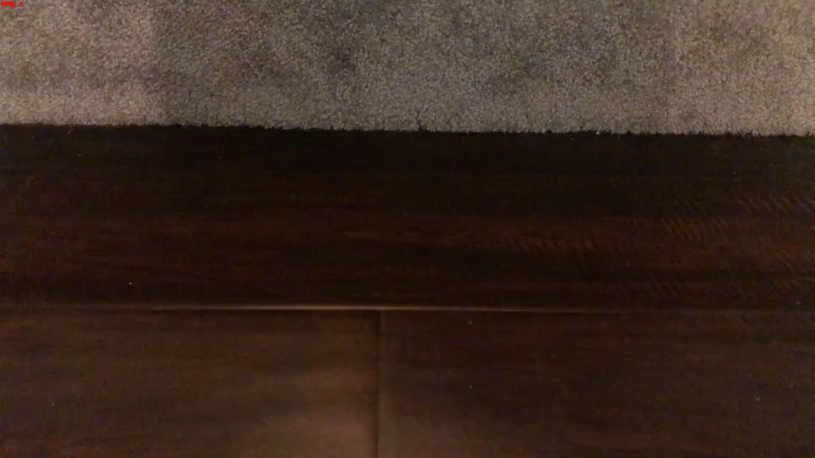
YOLO Video Results

Slide 20
Challenges & Future Work
Challenge | Future Work
Manually Tagging Images | Get someone else to do it… as is tradition
Increase Accuracy | Find the number of images that accuracy is sufficient
Object Overlap Detection | Limitation of YOLO, but play around with hyperparameters
 | Break Object Detection down to the Parts of an Object (tire on a car)
Notes:
In conclusion, I want to discuss various challenges and perhaps some future work to help.
First, manually tagging images is a pain, especially when you have a ton of them… the take away? Go the google route and get someone else to do it. Perhaps create a website for people to help in tagging.
Second

Slide 21
Acknowledgements
Bellevue University Data Science Department
Nick Lalone & Catie Williams
DSC680 Cohort
My son who loves Pokémon and inspired this project
Notes:
Thank you very much watching.
This is my final project and I would like to acknowledge the Bellevue University’s Data Science Department, all my professors along the way, especially Nick LaLone who did a great job setting up the program initially, and Catie Williams who stepped in after to lead the program and has done a fantastic job. I also want to thank all my cohorts whom I’ve had the pleasure of working alongside and learning from. But most importantly, I want to thank my son who inspired this project and had to sacrifice while I worked towards my degree.
Thank you all again.

Slide 22
References
Dwivedi, H. (2018, August 02). Pokemon Generation One. Retrieved May 06, 2020, from https://www.kaggle.com/thedagger/pokemon-generation-one
Girshick, R., Donahue, J., Darrell, T., &amp; Malik, J. (2014). Rich Feature Hierarchies for Accurate Object Detection and Semantic Segmentation. 2014 IEEE Conference on Computer Vision and Pattern Recognition. doi:10.1109/cvpr.2014.81
Girshick, R. (2015). Fast R-CNN. 2015 IEEE International Conference on Computer Vision (ICCV). doi:10.1109/iccv.2015.169
J. R. Uijlings, K. E. Sande, T. Gevers, and A. W. Smeulders. (2013). Selective Search for Object Recognition. Int. J. Comput. Vision 104, 2 (September 2013), 154–171. doi:https://doi.org/10.1007/s11263-013-0620-5
Muehlemann, Anton. “AntonMu/TrainYourOwnYOLO.” GitHub, 14 May 2020, github.com/AntonMu/TrainYourOwnYOLO
Redmon, J., Divvala, S., Girshick, R., & Farhadi, A. (2016). You Only Look Once: Unified, Real-Time Object Detection. 2016 IEEE Conference on Computer Vision and Pattern Recognition (CVPR). doi: 10.1109/cvpr.2016.91
Redmon, J., & Farhadi, A. (2017). YOLO9000: Better, Faster, Stronger. 2017 IEEE Conference on Computer Vision and Pattern Recognition (CVPR). doi: 10.1109/cvpr.2017.690
Redmon, J. Farhardi, A. (2018) YOLOv3: An Incremental Improvement.
Remanan, S. (2020, February 08). Beginner's Guide to Object Detection Algorithms. Retrieved May 15, 2020, from https://medium.com/analytics-vidhya/beginners-guide-to-object-detection-algorithms-6620fb31c375
Ren, S., He, K., Girshick, R., &amp; Sun, J. (2017). Faster R-CNN: Towards Real-Time Object Detection with Region Proposal Networks. IEEE Transactions on Pattern Analysis and Machine Intelligence, 39(6), 1137-1149. doi:10.1109/tpami.2016.2577031
Sharma, P. (2020, May 24). Introduction to Object Detection Algorithms. Retrieved May 17, 2020, from https://www.analyticsvidhya.com/blog/2018/10/a-step-by-step-introduction-to-the-basic-object-detection-algorithms-part-1/

